Slide 1



Department of Artificial Intelligence and Data science
InnFolio: Intelligent Financial Solutions for Enterprises
Guided By Dr.P.Indira priya
Done By A.Karthik(221801023) V.Maiyazhagan(221801032)
Professor

Slide 2
Problem Statement and Motivation
□
Developing a software solution to manage billing,income tracking,expense
reporting and daily expenditure logging for the lodge business ensuring comprehensive financial oversight and efficiency

Slide 3
Objectives
❏ Ensure Accurate Financial Tracking: Provide precise and real-time
monitoring of billing, income, and expenses to minimize errors and enhance
financial oversight.
❏ Streamline Financial Operations: Automate and integrate billing, income
tracking, and expense reporting processes to improve efficiency and reduce
manual effort.
❏ Enhance Financial Reporting: Offer comprehensive and customizable
reports to facilitate better decision-making and financial planning.
❏ Improve User Experience: Design intuitive and user-friendly interfaces
and guests alike, leading to increased satisfaction and engagement.

Slide 4
Abstract
□
□
□
"InnFolio" offers a comprehensive financial management system designed
specifically for hospitality businesses, addressing the industry's need for efficient,
unified financial operations.
The system leverages advanced LSTM machine learning algorithms to automate
key financial tasks such as billing, income tracking, and expense reporting,
reducing manual effort and minimizing errors.
By providing real-time data analysis and predictive insights, the system offers
detailed financial oversight, enabling better decision-making and strategic
planning for hospitality businesses.

Slide 5
Introduction and Overview of the Project.
Streamlined Financial Operations: The software efficiently manages billing, income tracking, and expense reporting through automation and real-time data processing, ensuring smooth financial operations.
User-Friendly Interface: With an intuitive interface and comprehensive reporting tools, the software simplifies invoicing, payment tracking, and daily expenditure logging, making it easy for users to manage finances.
Enhanced Accuracy and Decision-Making: The solution enhances financial accuracy and efficiency, providing actionable insights that support better decision-making for hospitality businesses.

Slide 6
Literature Survey
S.No | Author Name | Paper Title | Description | Jornal | Volume/ Year
1 | Viachaslau Filimonau | The blockchain technology and the scope of its applicationn hospitality Operations | Explores blockchain's benefits and challenges in hospitality, enhancing transparency, security, and supply chain management. | - | 2019
2 | Ineˆs Cruz | International Journal of Contemporary Hospitality Managemen | Combines traditional and new techniques to improve decision- making and strategic planning in hospitality performance management. | International Journal of Contemporary Hospitality Management | 2007
3 | Yusaf H. Akbar, Andrea Tracogna | The sharing economy and the future of the hotel industry: Transaction cost theory and platform | Examines digital transaction systems' positive impact on communication, efficiency, and customer service in Rivers State's hospitality industry. | Innovative Journal of Human Resource and Management | 2017

Slide 7
Literature Survey
S.No | Author Name | Paper Title | Description | Jornal | Volume/ Year
4 | Marianna Sigala | Integration customer relationship Management in hotel operations: managerial and operational | This paper discusses integrating Customer Relationship |  | 2005
 |  | implications | Management (CRM)
 |  |  | with Information and
 |  |  | Communication
 |  |  | Technology (ICT) to
 |  |  | improve customer
 |  |  | retention and satisfaction
 |  |  | in the hotel industry
5 | Prof. Sam Otamiri | WORKPLACE ONLINE TRANSACTION SYSTEM AND | transaction systems impact communication, |  | 2022
 |  | ORGANIZATIONAL HEALTH | operational efficiency,
 |  | OF HOSPITALITY INDUSTRY | and customer service
 |  | OPERATORS IN RIVERS STATE | health in Rivers State's
 |  |  | hospitality industry

Slide 8
Existing System
❏ | Manual Processes: Paper-based invoices, receipts, and logs for tracking
 |  |  | transactions.
❏ Generic Accounting Software: Software like QuickBooks or Excel spreadsheets
for managing finances, often with limited customization options specific to the
hospitality industry
❏ Multiple Disparate Tools: Separate tools for different functions, such as billing,
expense tracking, and reporting, leading to fragmented data management.

Slide 9
Drawback of Existing System
❏ Lack of Integration: The use of multiple separate tools often results in
fragmented data, making it challenging to obtain a comprehensive view of the lodge's
financial status. This lack of integration can lead to inefficiencies and increased
chances of data inconsistency.
❏ Manual Data Entry and Errors: Manual processes and spreadsheets require
significant data entry, which is time-consuming and prone to human error. Mistakes
in data entry can lead to inaccurate financial reports and decision- making.

Slide 10
Proposed System
❏
Billing Management System: This system handles invoice generation, payment
processing, and recurring billing. It ensures that all guest charges are accurately billed, payments are processed efficiently, and any recurring charges are managed seamlessly.
❏
Income Tracking System: This system provides real-time tracking of income
from various sources, such as room bookings, services, and events. It categorizes income streams and generates comprehensive reports to help monitor revenue and financial performance.
❏
Expense Management System: This system records and all expenses, from
utilities to staff salaries. It includes budgeting tools to monitor expenses against budgets and generates reports to analyze costs and optimize spending.

Slide 11
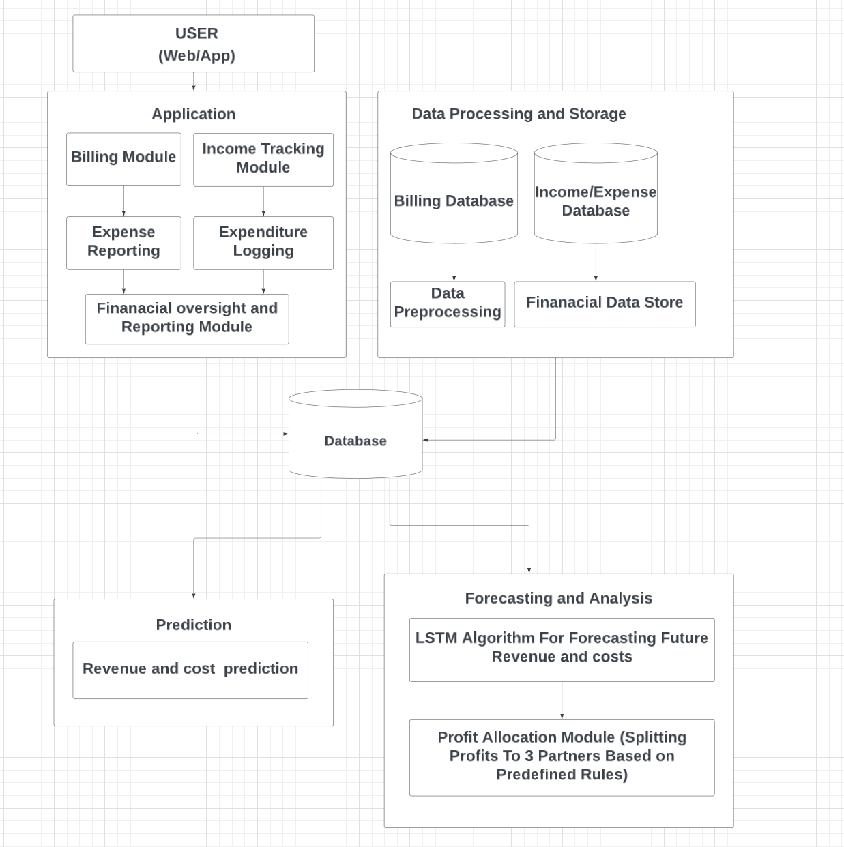
System Architecture

Slide 12
Methodology
Data Collection and Preparation: Gather historical financial data and preprocess it by cleaning, normalizing, and transforming it into time series sequences suitable for analysis.
LSTM Training and Prediction: Train the LSTM model using the prepared data, validate its accuracy, and use it to forecast future revenue, expenses, and financial trends.

Slide 13
List Of Modules
Application
Data Processing and Storage
Prediction
Forecasting and Analysis

Slide 14
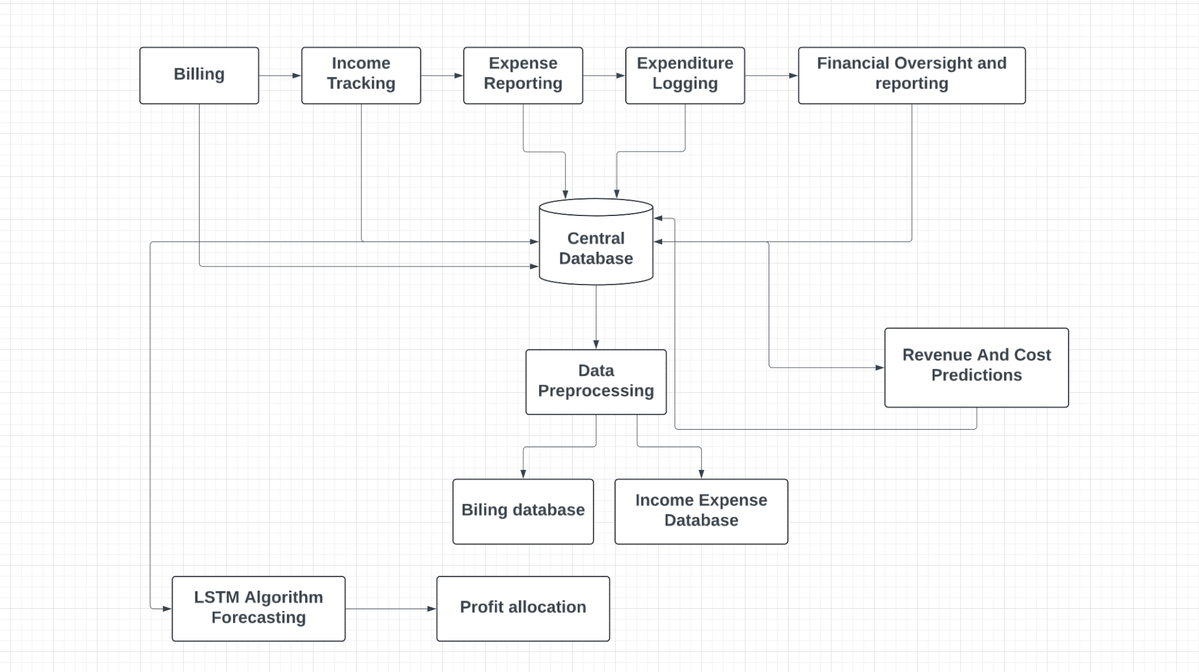
Data Flow Diagram

Slide 15
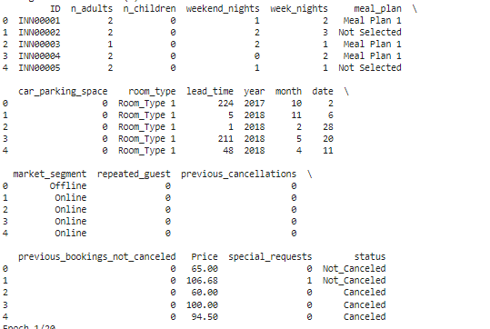
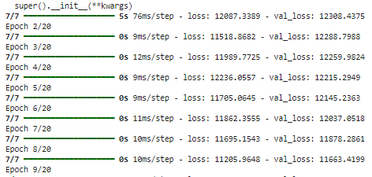
OUTPUT
Data Processing and Storage Layer

Slide 16
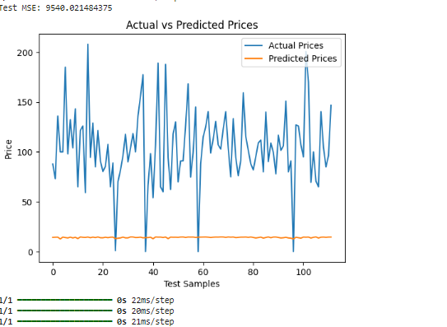
OUTPUT
Prediction Layer

Slide 17
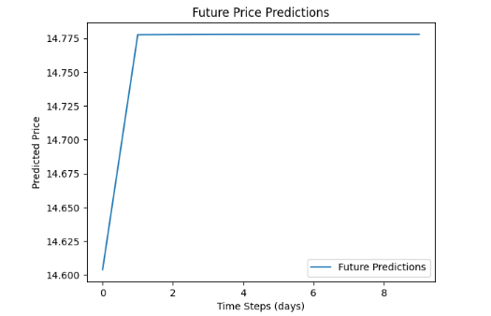
OUTPUT
Forecasting and Analysis Layer

Slide 18
References.
Thakur, R., & Shrivastava, A. (2021). "Financial Management in the Hospitality Industry: A Study on Technology Integration." Journal of Hospitality Financial Management, 29(1), 45-58.
Gursoy, D., Chi, C. G., & Chi, O. H. (2022). "The Role of Financial Management Practices in the Success of Small and Medium Lodging Businesses." International Journal of Hospitality Management, 99, 103066.
Kim, S., & Lee, S. (2023). "The Impact of Real-Time Data Analysis on Financial Decision-Making in the Hospitality Sector." Journal of Hospitality and Tourism Technology, 14(2), 156-174.

Slide 19
Thank You
Zeroth Review

